Slide 1
Cayley Hamilton theorem :
Every square matrix satisfies its own characteristic equation.
Examples :
3 1 2
1.Verify Cayley Hamilton theorem for the matrix A = 4 3 1
2 5 4
Solution :
We have to find the characteristic equation | A – λI | = 0
3-λ 1 2
| A – λI | = 4 3-λ 1
2 5 4-λ
= (3-λ) [(3-λ)(4-λ)-5] -1 [4(4-λ)-2] + 2[20-2(3-λ)]

Slide 2
= (3-λ) (λ²-7λ+7) – (14-4λ) + 2(14+2λ)
=-λ³+10λ²-20λ+35
Therefore the characteristic equation is,
-λ³+10λ²-20λ+35 = 0
Therefore, we have to prove that
A³-10A²+20A-35 = 0
Now to find A² and A³
A²=A*A
3 1 2 3 1 2
A² = 4 3 1 4 3 1
2 5 4 2 5 4

Slide 3
17 16 15
= 26 18 15
34 37 25
A³ = A²*A
17 16 15 3 1 2
= 26 18 15 4 3 1
34 37 25 2 5 4
145 140 110
= 180 155 130
300 270 205
Substitute A, A², A³ and I in the characteristic equation.

Slide 4
A³ - 10A² + 20A - 35I
145 140 110 17 16 15 3 1 2 1 0 0
= 180 155 130 -10 26 18 15 +20 4 3 1 -35 0 1 0
300 270 205 34 37 25 2 5 4 0 0 1
0 0 0
= 0 0 0 =0
0 0 0
Hence Cayley Hamilton theorem is verified.
2. Verify Cayley Hamilton theorem and hence find the matrix

Slide 5
1 2 -1
3 -3 1
2 1 -2
Solution :
1 2 -1
Let A = 3 -3 1
2 1 -2
1-λ 2 -1
| A – λI | = 3 -3-λ 1
2 1 -2-λ
= (1-λ) [(-3-λ)(-2-λ)-1] -2 [3(-2-λ)-2] -1 [3-2(-3-λ)]
= (1-λ) (λ²+5λ+5) –2 (-8-3λ) -1 2(9+2λ)
= -λ³-4λ²+4λ+12

Slide 6
Therefore the characteristic equation is,
-λ³ -4λ² +4λ +12 = 0
we have to prove that A³ +4A² -4A -12I = 0
To find A² and A³,
A²=A*A
1 2 -1 1 2 -1
A² = 3 -3 1 3 -3 1
2 1 -2 2 1 -1
5 -5 3
= -4 16 -8
1 -1 3

Slide 7
A³ = A²*A
5 -5 3 1 2 -1
= -4 16 -8 3 -3 1
1 -1 3 2 1 -2
-4 28 -16
= 28 -64 36
4 8 -8
Substitute A, A², A³ and I in the characteristic equation
A³ +4A² -4A -12I
-4 28 -16 5 -5 3 1 2 -1 1 0 0
= 28 -64 36 -4 -4 16 -8 -4 3 -3 1 -12 0 1 0
4 8 -8 1 -1 3 2 1 -2 0 0 1

Slide 8
0 0 0
= 0 0 0 =0
0 0 0
Hence Cayley Hamilton theorem is verified
To find Inverse :
We have A³ +4A² -4A -12I = 0
Multiply by A⁻¹ we get,
A⁻¹A³ + A⁻¹A² – 4A⁻¹A – 12A-1I = 0
A² +4A -4I – 12A⁻¹ = 0
12A⁻¹ = A² +4A -4I
A⁻¹ = 1/12 [ A² +4A -4I]

Slide 9
5 -5 3 1 2 -1 1 0 0
= 1/12 -4 16 -8 +4 3 -3 1 -4 0 1 0
1 -1 3 2 1 -2 0 0 1
5 3 -1
= 1/12 8 0 -1
9 3 -9

Slide 10
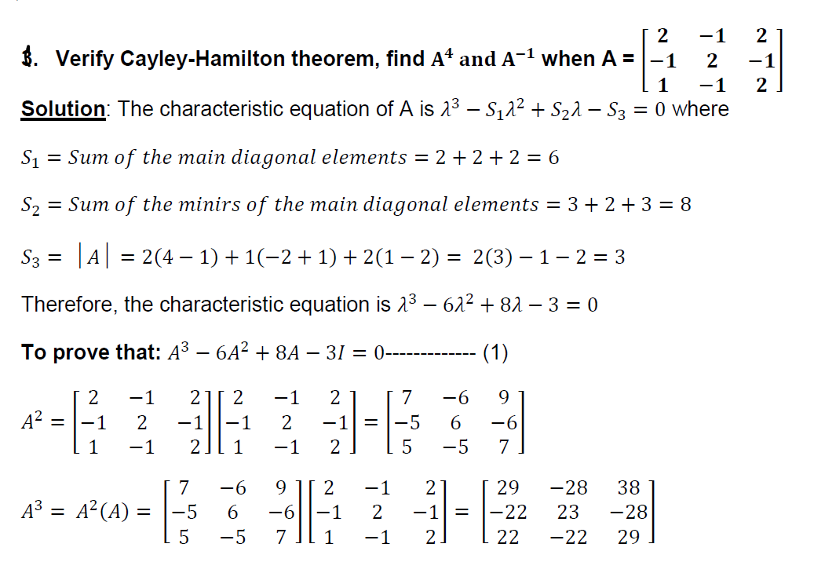

Slide 11
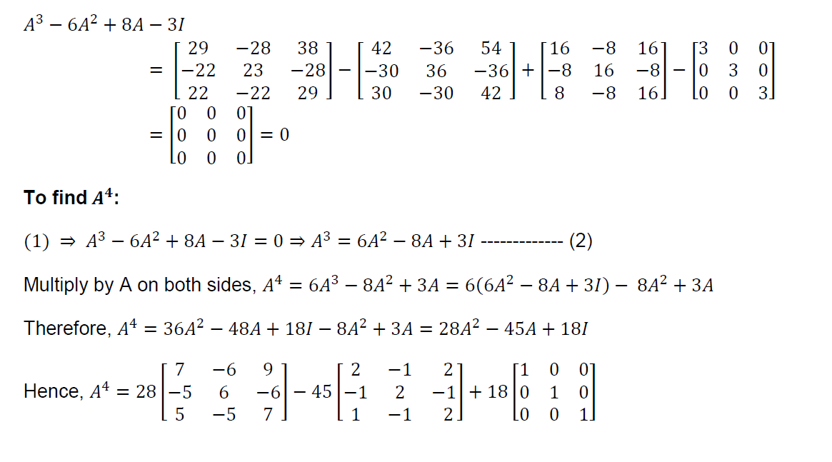

Slide 12
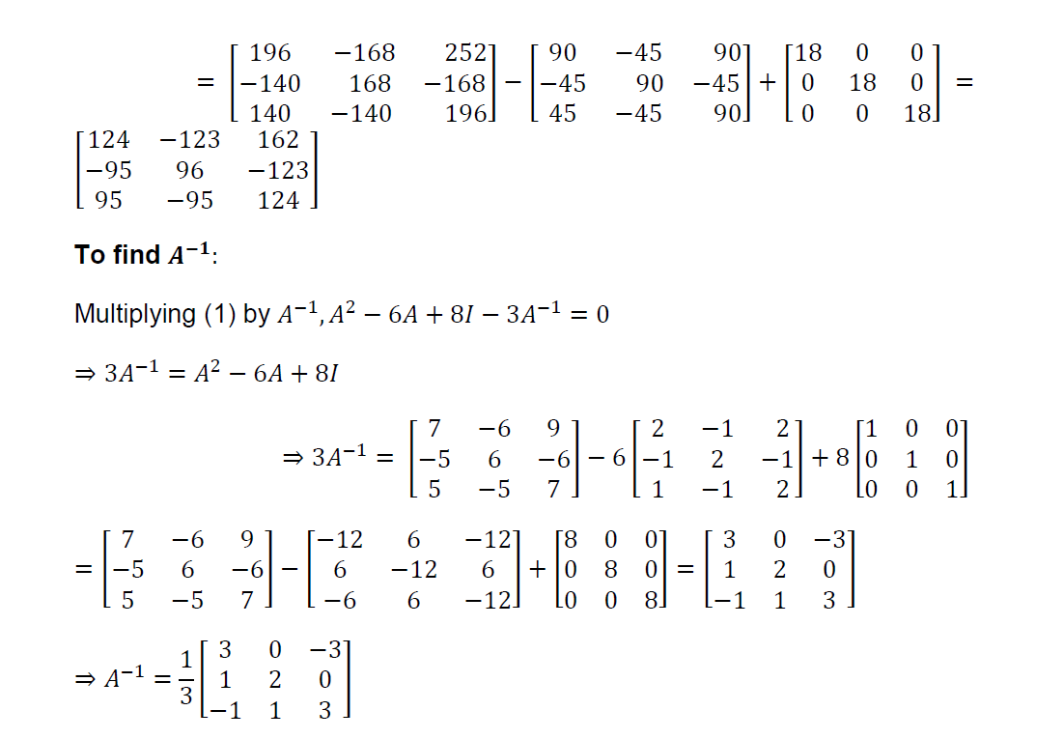

Slide 17
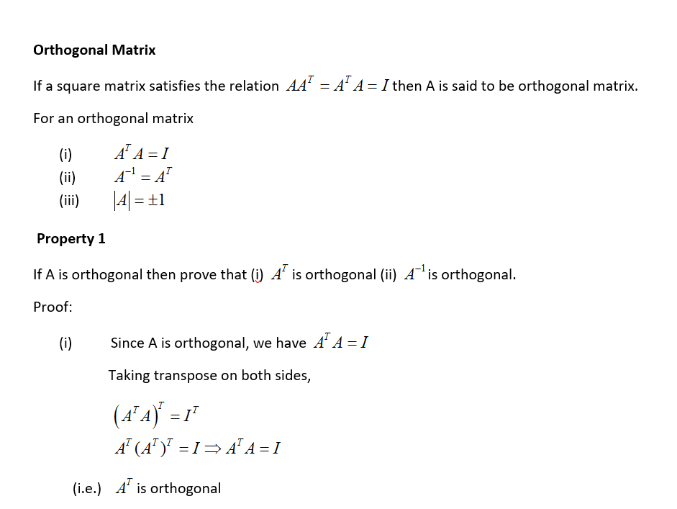

Slide 18
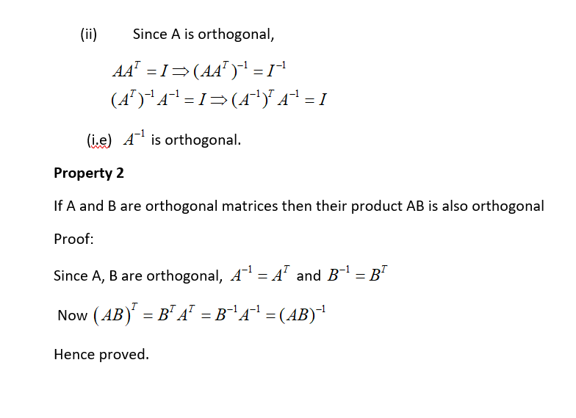

Slide 19
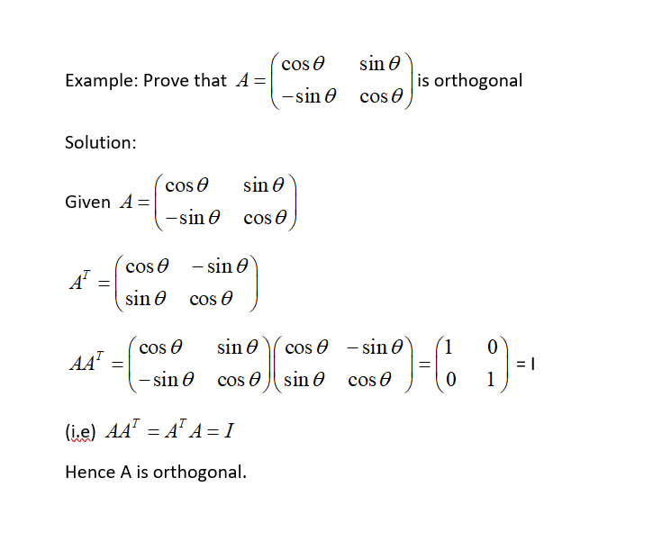

Slide 20
.
Diagonalisation of a matrix by Orthogonal Transformation
Let A be a symmetric matrix. Form a matrix N whose columns are normalized eigen vectors of A. Since N is orthogonal we use
Again which is called orthogonal reduction or transformation.

Slide 21
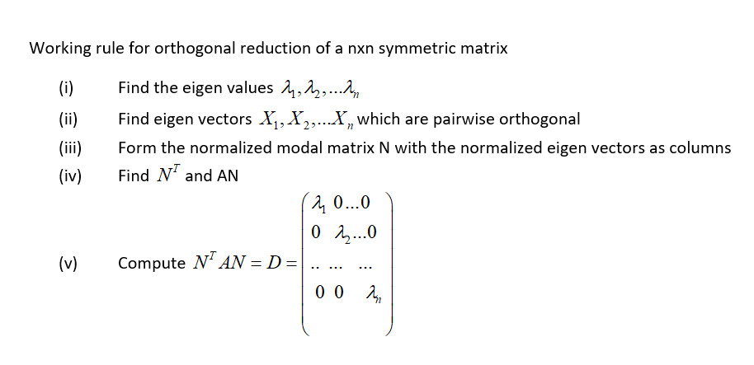

Slide 22
1.Diagonalise the matrix
by means of orthogonal transformation.
Solution: Characteristic equation of A is

Slide 23
are the eigen values.
To find eigen vectors:
Let
(1)
⇒
When
Equation (1) becomes

Slide 24
Solve by using cross multiplication method, we have
Eigen vector for is

Slide 25
When , equation (1) becomes
Let we get
Eigen vector for is

Slide 26
To find the third eigen vector since the
matrix is symmetric.
Let us choose such that and
and
and

Slide 27
Normalized modal matrix
Now

Slide 28
2. Diagonalise by means of
orthogonal transformation.
Solution:
Let
Characteristic equation of A is
.
.

Slide 29
Let
To find the eigen vectors:

Slide 30
,
When , eigen vector
When ,eigen vector
When , eigen vector
Normalized modal matrix

Slide 31
Diagonal form of the matrix,
D = N^{T} A N
2 2 1
1 3 1
1 2 2
-2 /√5 1/√5 0
-2 /√5 1/√2 1/√3
=
1/√2 0 -1 /√2
1/√5 0 1 /√3
1/√3 1/√3 1/√3
0 -1/√2 1/√3
5 0 0
0 1 0
0 0 1
=

Slide 32
Problem for practices
2 -1 1 3 -1 0
-1 2 -1 2) -1 2 -1
1 -1 2 0 -1 3

